Slide 1


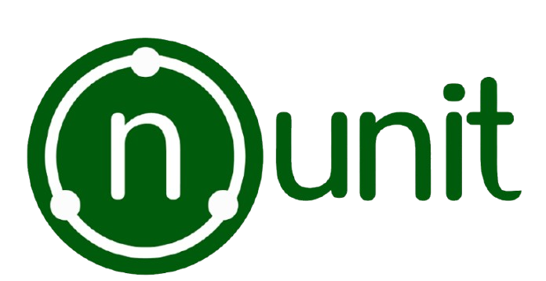

Software Testing Tool Evaluation – NUnit (C#)
NUnit is a popular open-source unit testing framework for .NET, used to automate and structure C# testing.
Minthaka - IT23372580
Chanuka - IT23372658
Nandun - IT23279766

Slide 2

Purpose & Domain
Purpose of NUnit
Automate Unit Testing - Verify .NET code components for correctness
Ensure Code Quality - Improve reliability and prevent regressions
Enable TDD - Write tests before implementation code
Early Bug Detection - Identify defects early in development cycle
Domain
Platform: .NET Framework, .NET Core, .NET 5/6+
Language: Primarily C# applications
Users: .NET developers and QA engineers
Methodology: Agile, TDD, and CI/CD workflows

Slide 3
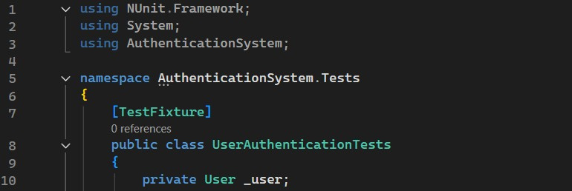
Key Features
Attribute-Driven Model
Declare tests with [Test], [SetUp], and [TearDown].
Rich Assertions
Validate logic with Assert.AreEqual(), Is.True, etc.
Parameterized Tests
Run with multiple inputs using [TestCase].
Structured Organization
Group tests into fixtures and categorize for efficiency.
Seamless Integration
Works natively with Visual Studio and CI/CD pipelines.
Example:

Slide 4
NUnit Workflow
Install NUnit & Test Adapter
Via NuGet:
Install-Package NUnit
Install-Package NUnit3TestAdapter
Create Test Project
Add a new Unit Test Project (.NET Core) in Visual Studio.
Write Test Classes
Decorate methods with [Test], [SetUp], [TearDown].
Run Tests
Run using Test Explorer or CLI:
dotnet test
View Results
Pass/Fail with detailed assertions.

Slide 5
References
https://nunit.org/
https://learn.microsoft.com/en-us/dotnet/core/testing/unit-testing-csharp-with-nunit

Slide 6

Thank You

